Slide 1
Enhancing Staff Data Collection and Analysis to Foster Inclusivity
Freen Mehdi and Byron Batten

Slide 2
Join the Vevox session
Go to vevox.app
Enter the session ID: 136-125-103
Or scan the QR code

Slide 3
How comfortable or uncomfortable do you feel about disclosing your personal demographic data to your current employer?
##/##
Join at: vevox.app
ID: XXX-XXX-XXX
Question slide
Very uncomfortable
Very comfortable
I feel...

Slide 4
How comfortable or uncomfortable do you feel about disclosing your personal demographic data to your current employer?
##/##
Join at: vevox.app
ID: XXX-XXX-XXX
Results slide
Very uncomfortable
Very comfortable
I feel...
RESULTS SLIDE

Slide 5
Why are there barriers to collating staff data?
##/##
Join at: vevox.app
ID: XXX-XXX-XXX
Question slide

Slide 6
Why are there barriers to collating staff data?
##/##
Join at: vevox.app
ID: XXX-XXX-XXX
Results slide
RESULTS SLIDE

Slide 7
Examples of mistrust
Mistrust – is it anonymous? "prefer not to say“ Sensitive/ emotive data (socio-economic questions)
Example; A CIPD survey of ethnic minority employees found that they were more likely to say that the identity of their background could impact the opportunities given at work. https://www.cipd.org/uk/knowledge/cipd-knowledge-archive
Research by Scope found one reason disabled people do not disclose their disability at work is fear it may limit their employment and progression opportunities. https://wp.financialservicesskills.org/wp-content/uploads/2020/10/Diversity-Data-the-challenges-of-data-collection.pdf

Slide 8
Barriers
No protected time/ lack of resources
Staff not involved
No purpose/ communication (R&D)
Tokenism
Security/GDPR
Limited awareness/understanding
Lack of standardisation
Fear of repercussions
Resistance to change
Language
Organisational Culture
Historical distrust of collection
Complexity of intersectionality

Slide 9
The need for staff data
Measure our people
Career development
Measure success/ thriving
Develop relationships with public
Set benchmarks

Slide 10
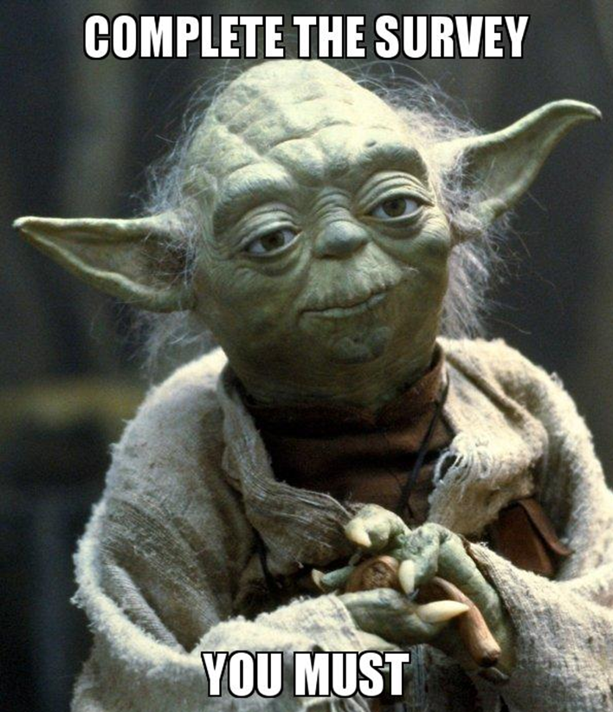

What can we do?

Slide 11
What we will do – We need GOOD data
Staff involvement Focus groups/ qualitative data
Communication - intranet, networking, training and social media
“You Said, We Did” campaign
Leaders reinforce and protect time of staff
Cultural and organisational awareness - resources
Health & Wellbeing
Improving trust through transparency
Anonymous or confidential surveys

Slide 12
What could be the impact
Recent R&D staff survey highlighted that 51% of our staff had caring responsibilities.
We can utilise this data to determine how effective our flexible working policies are and make reasonable changes.
We can promote staff involvement and show tangible results from data collection and analysis.
We can measure the results year on year to analyse the impact of changes made.

Slide 13
The outcomes
This will not eliminate all issues, there may be unreliable data, staff that do not respond and staff may still select “prefer not to say”
However, we can make the positive steps to improve data collection

Slide 14
Thank you
Any questions?

